Slide 1
Introduction to Python
Konstantin Ilyashenko
e-mail: Konstantin_Ilyashenko@epam.com
Skype: k.ilyashenko
CONFIDENTIAL | © 2020 EPAM Systems, Inc.

Slide 2
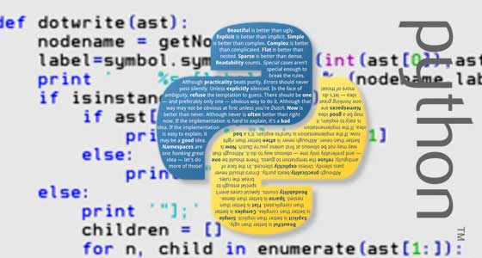
Goal
Course format
Homework
Advantages of Python
Short description of the language
Purpose
Pros and cons
Implementations

Slide 3



Python
Python 1.0 - 1994
Python 2.0 - 2000
Python 3.0 - 2008

Slide 4


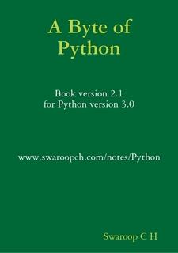


Books

Slide 5
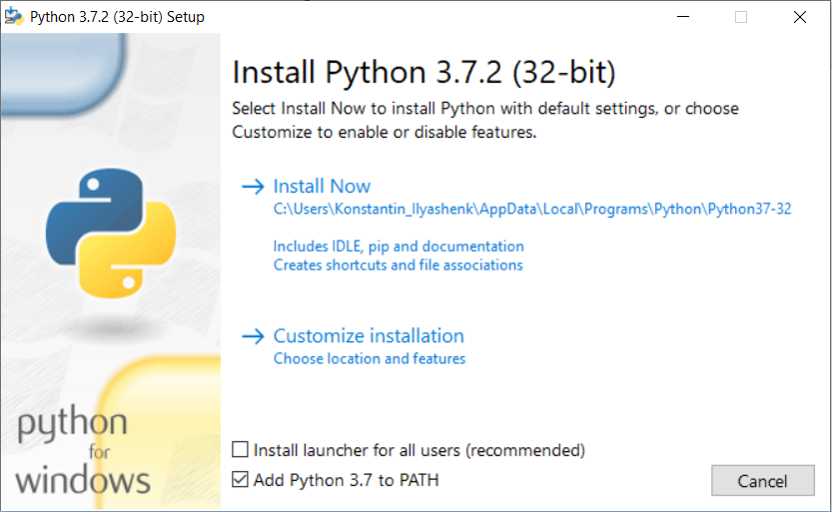
Installation python.org

Slide 6
Package managers
pip – standard package manager
conda – as part of the Anaconda project

Slide 7
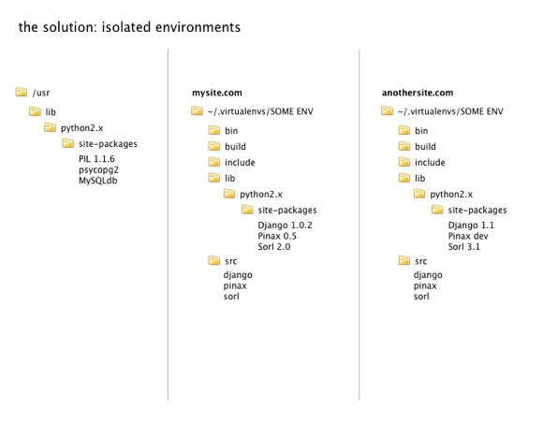
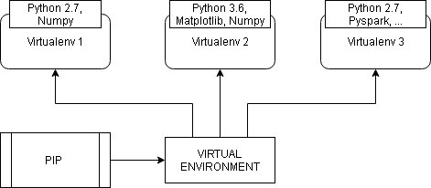
Virtual environments
Create environment
> python –m venv <venv_dir>

Slide 8
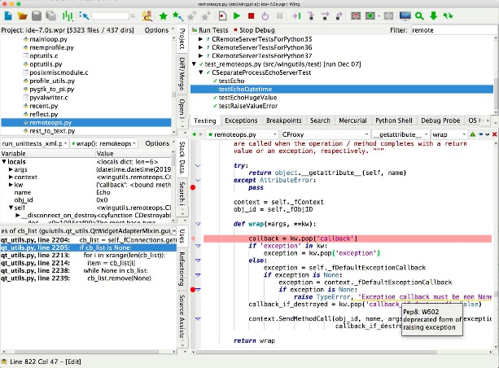
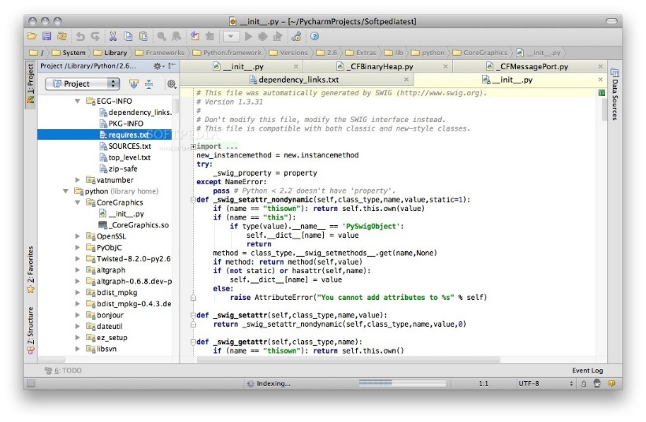
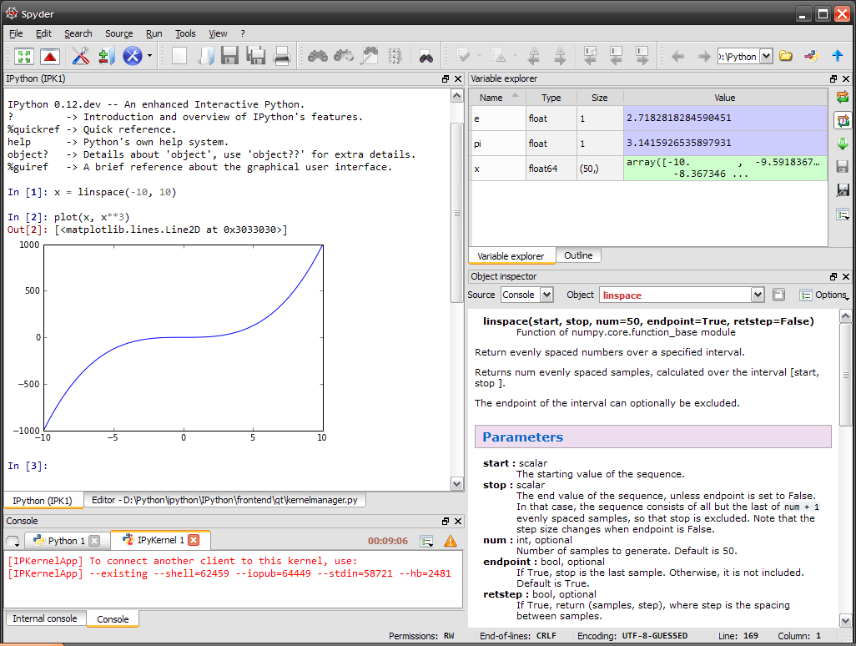
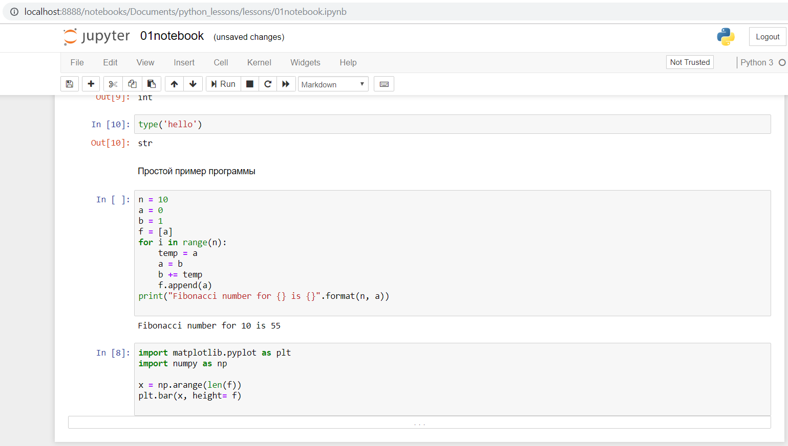
Python IDE
Wing
Pycharm
Jupyter
Spider

